Slide 1
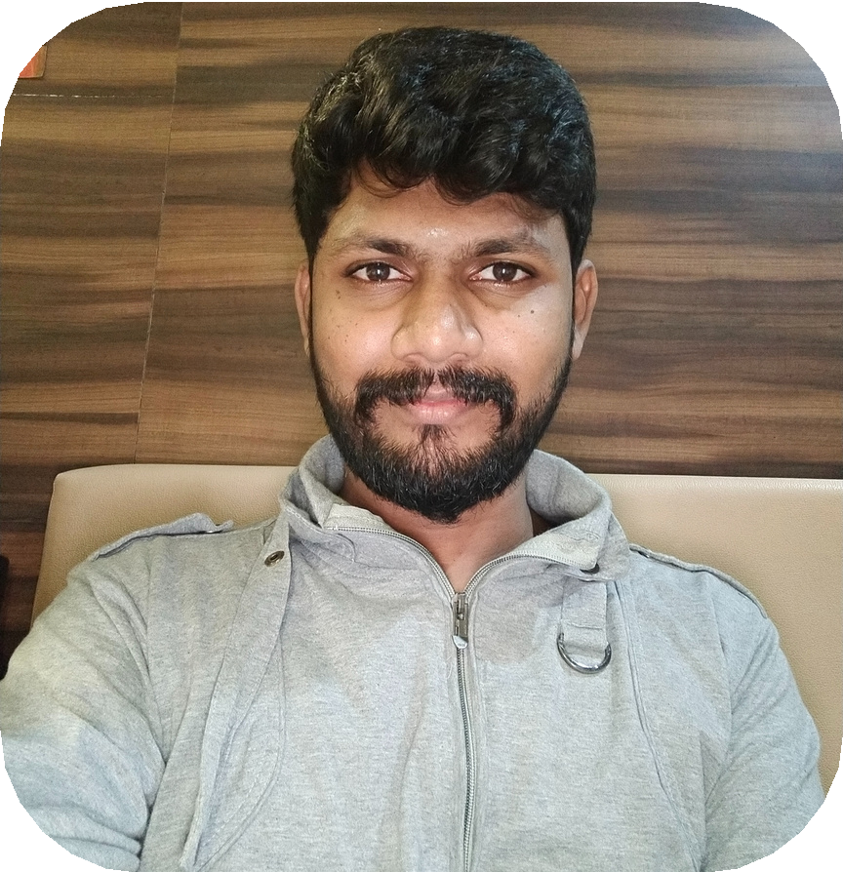
V M GOWDHAMAN
Java Developer
Email
gowdhaman10@gmail.com
Alternate Email gowdhaman11@gmail.com
Alternate Phone No +91-9655768276
Phone No
+91-7402788169
PROFESSIONAL SUMMARY
I am a software developer with robust problem-solving skills and proven experience in creating and designing software in a test-driven environment.
Experience in Java & J2EE Application development. Knowledge of Eclipse tool for the development of Java Projects.
Adaptive to learn new technologies.
Hands on experience in Core Java, MYSQL, JDBC, Spring Boot and tomcat server.
Easily mingle with any environment and hardworking nature.
Strong analytical, debugging skills with ability to learn and use new tools and techniques.
Good Team player and also have to work independently. Adaptive to learn new technologies.
CAREER SUMMARY
Software Engineer
Openappware solutions pvt ltd Nov 2019 to Jul 2022
Designs and creates software solutions to solve pain points for various clients
Modifies code to fix errors Developed and implemented software solutions based on client requirements
Tested and refined software prior to rollout
PROFESSIONAL SKILLS
Competence / Skillset
Java, J2EE, MySQL, Postman, SpringBoot, Microservices
Tools / Technology
VCS
Tools / Servers Database
: Git, GitHub
: Apache Tomcat
: MySQL
Web Technologies : HTML5, JSON, CSS, JavaScript
Software : Eclipse IDE (2022-23), Visualstudiocode, Springtoolsuite 8.0, MySQL Workbench, Postman
KEY HIGHLIGHTS
Implements all the components of API including Controllers, Service, DAO, Repositories along with Exception Handling.
Extensive knowledge of Database accesses with JPA, Object relational mapping.
Working experience in the areas of distributes technologies like Core Java, J2EE, MySQL. Involving in Backlog gromming, daily standup calls, Demo/Review and Retrospective for analysis.
Good in using of microservice tools and some essential tools as Maven to communicate with servers.
EDUCATION
2014 - 2018 | SSM Institute Of Engineering And Technology
Bachelor of Mechanical Engineer - 68.70%
2012 - 2014 |
M.S.P. Solai Nadar Memorial Higher Secondary School
XII - 79.50%
2011 - 2012 |
M.S.P. Solai Nadar Memorial Higher Secondary School
X - 89.60%
PERSONAL PROFILE
WORK EXPERIENCE
Father's Name Date of Birth Gender Language Known Telugu
Permanent Address
: Mr. V.MURALI
: 02, Nov, 1996
: Male
: English, Tamil,
Project 1: Title Duration
: Hospital e-system.
: Nov 2019 to Jul 2020.
Description:
Client Name: RK's Care Center
Description: Main aim of this app to reduce the complications of paperwork and maintaining the diagnosis and treatment details effectively. Using this we can maintain the patient medical records (in-patient and out-patient), patient contact (and previous physician, caretakers, relatives etc.,) information, will keep track of appointment details, doctor's details, tracking payments, insurance module, discharge summary, operation theatre management, lab management, prescription management.
Project 2:
Colony, Nehruji Nagar, Dindigul.
: 17/12, Municipal
Present Address : 37/1, Gangaram Garden, Trust Puram, Kodambakkam, Chennai
DECLARATION
Title Duration
Description:
: Bus Ticketing.
: Jul 2020 to Jul 2022.
I hereby declare that all the information furnished above is true and genuine to the best of my knowledge.
Client Name: Lotus Transport
Description: This system will reduce the human effort on ticket booking and increase the customer satisfaction. It contains various modules like - Admin management, User management, Passenger Information, Employee information, Vehicle management - Vehicle live tracking, Travel Routes, Vehicle availability, Enquiry, Booking Information, Cancel Booking, Payment Information, Notification and messages.
(V.M.GOWDHAMAN)

